Slide 1

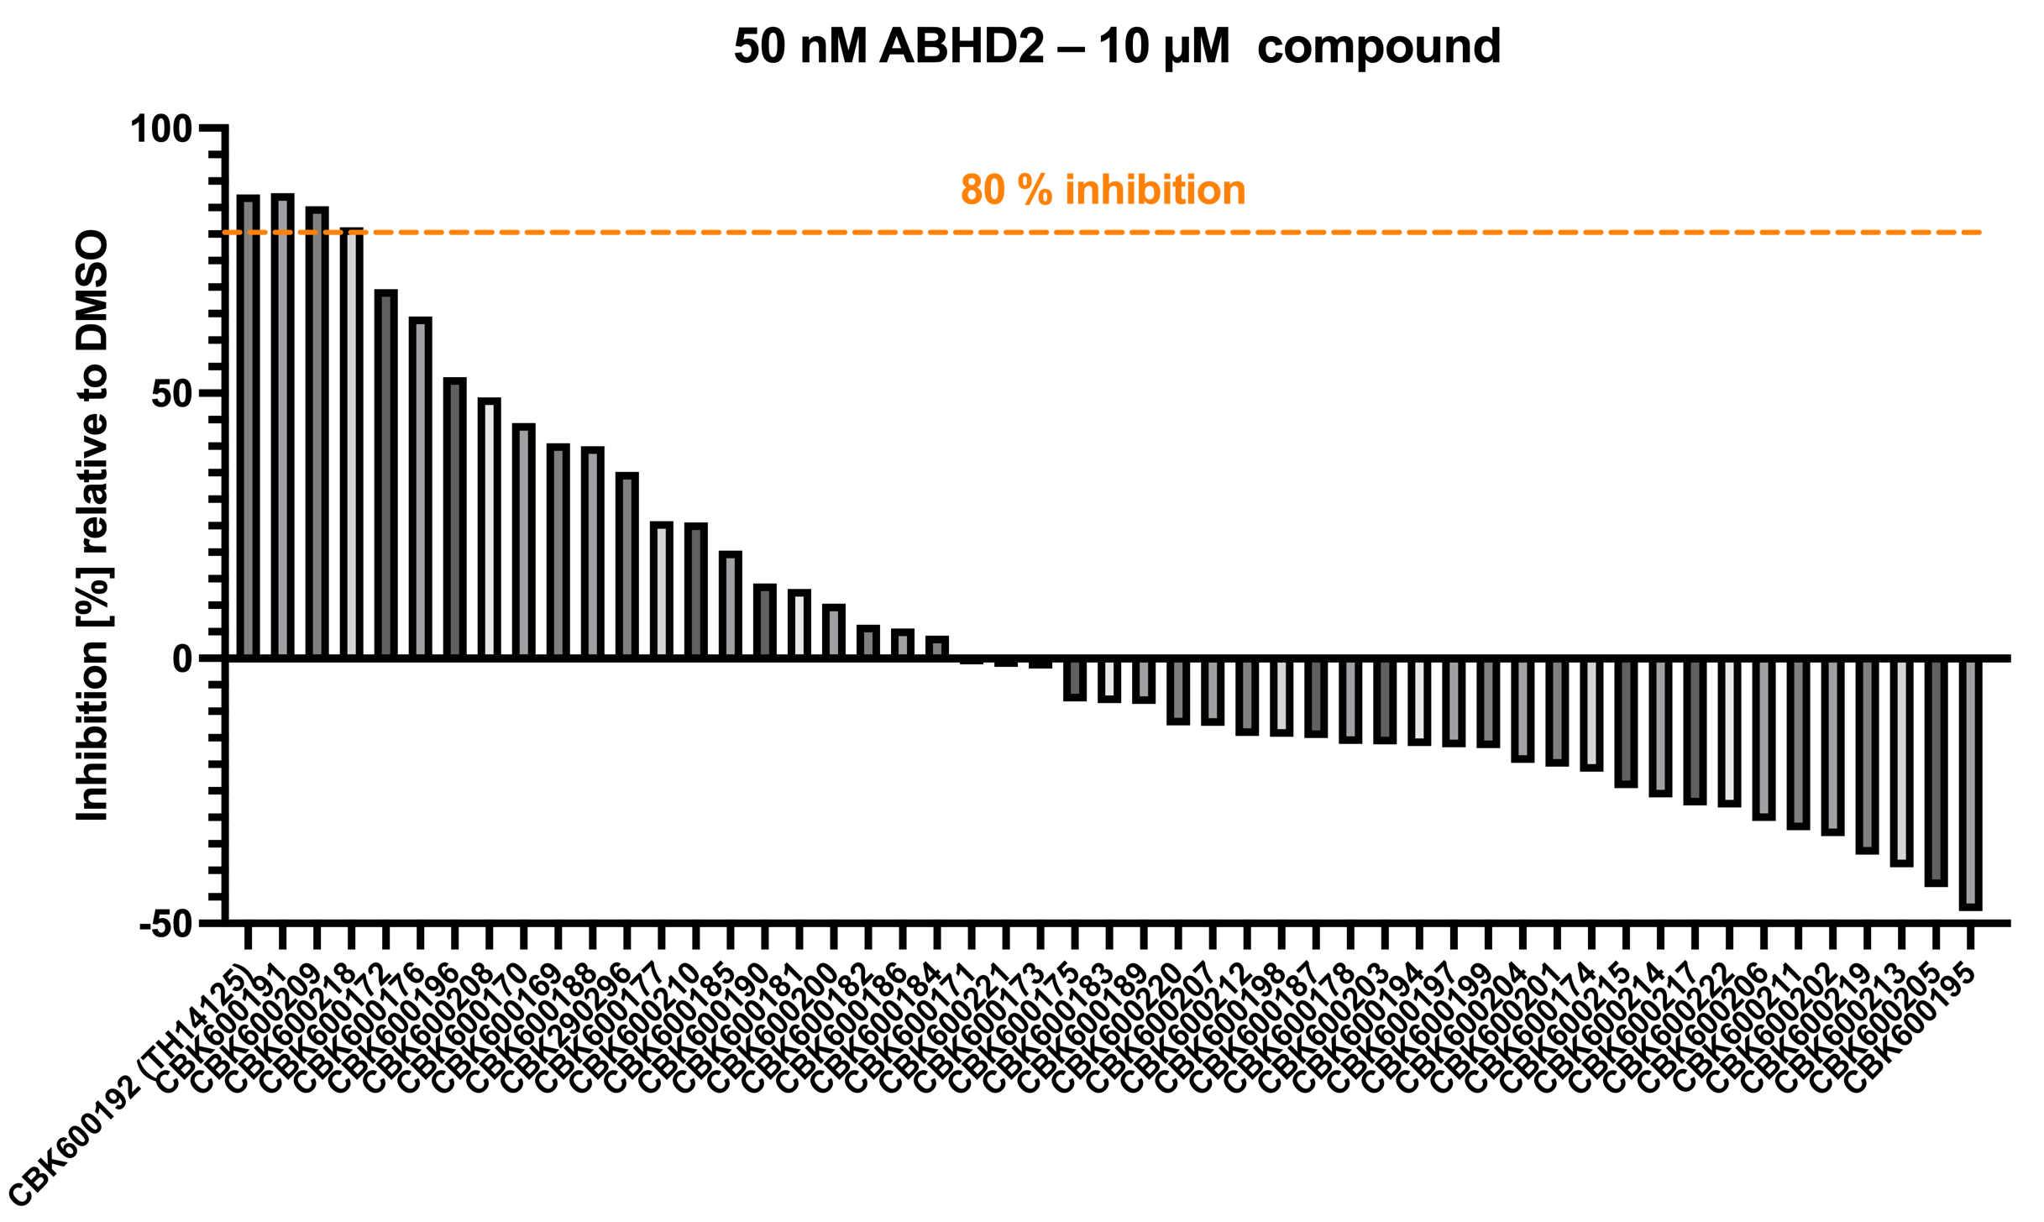
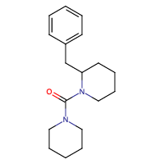
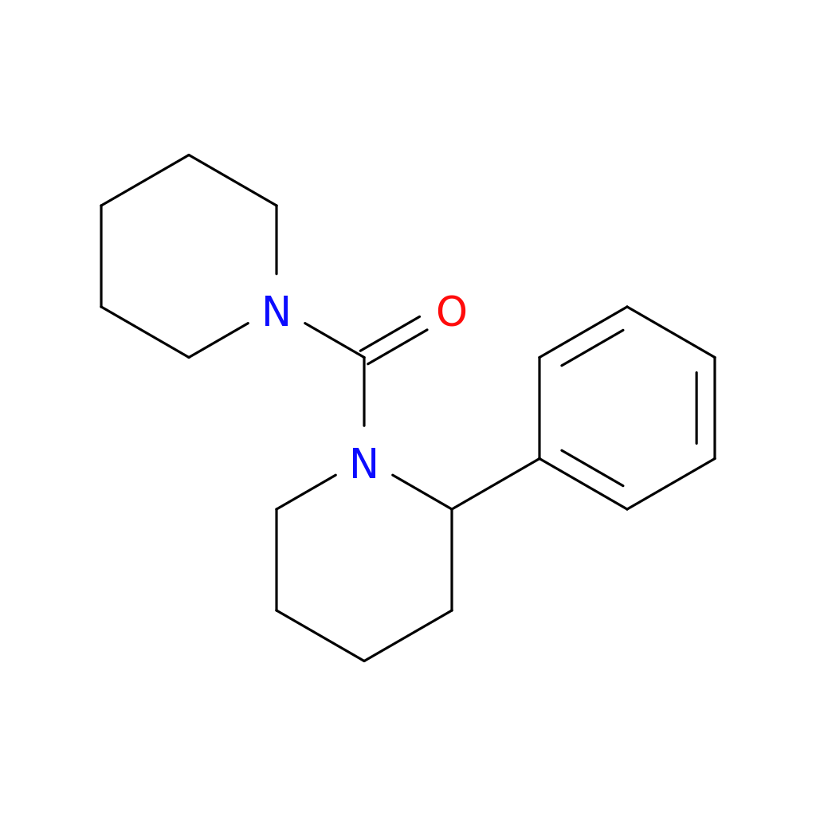
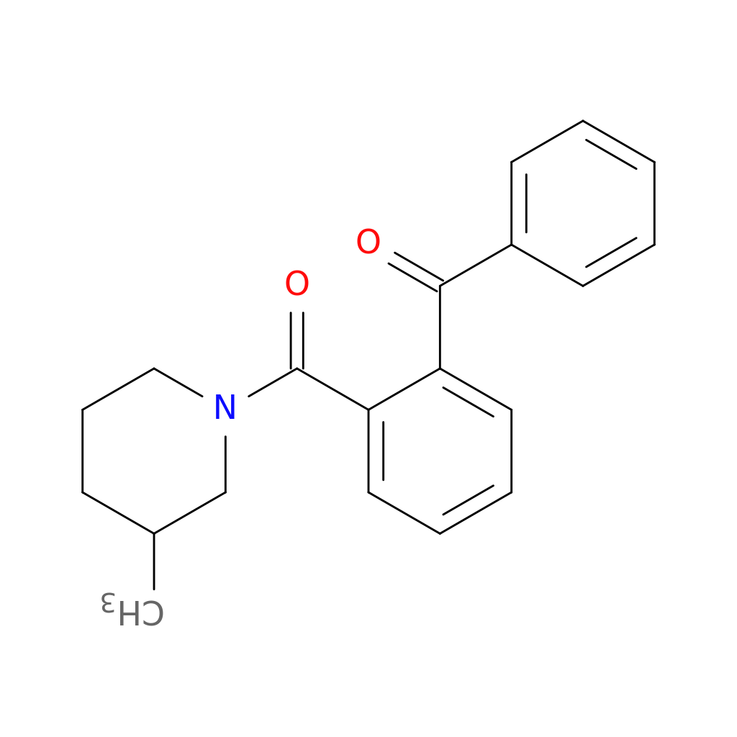
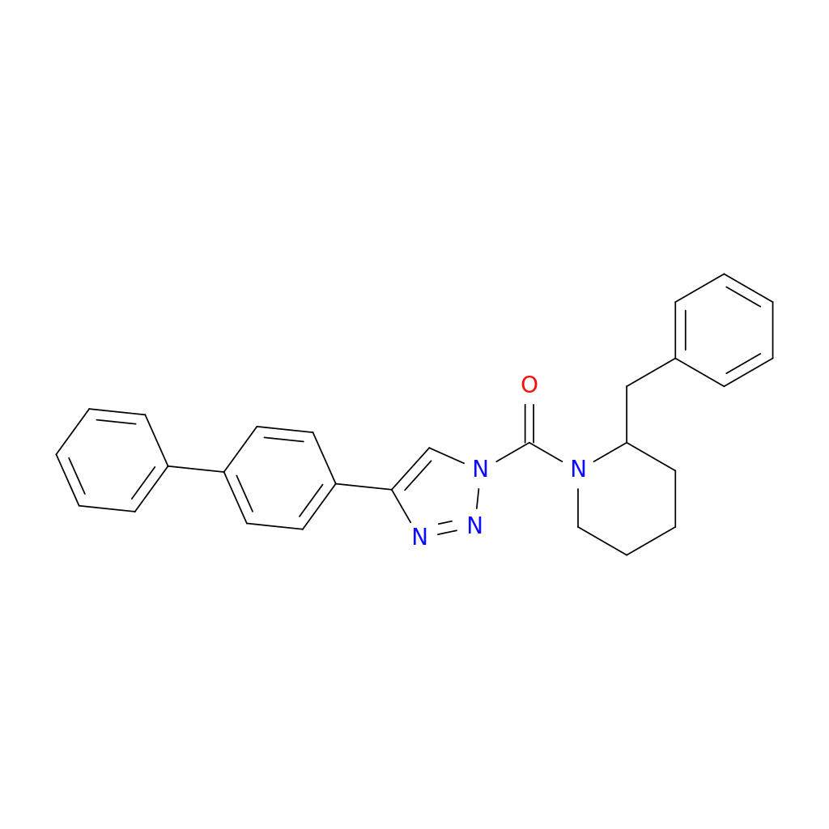

ABHD2 – Compounds – TH14125 derivatives
53 derivatives at single concentration measured in triplicates
30 min pre-incubation on ice with compound
Assay at 37 ºC for 20 min with 500 µM pNP octanoate
3 hits with similar potency as TH14125
→ Next: dose-response and validation
TH14125 – ABHD2i
Baggelaar et al., ACS, 2019
CBK600191
CBK600209
CBK600218

Slide 2
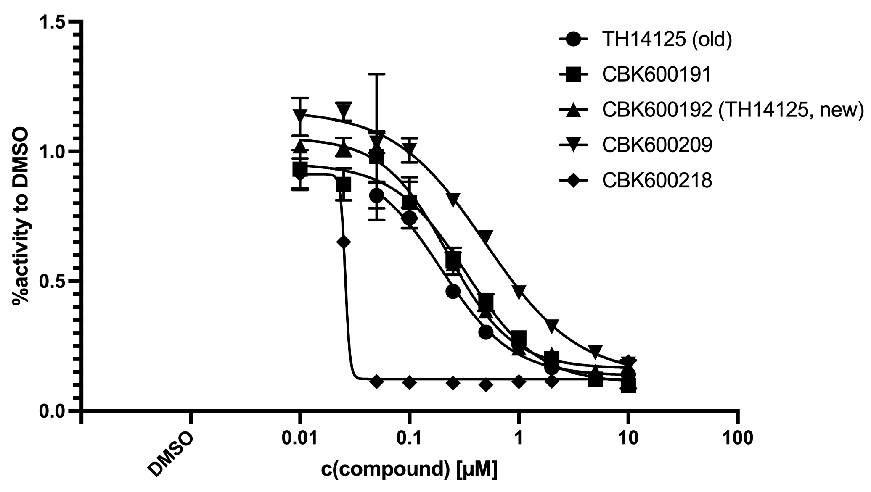
ABHD2 – Compounds – TH14125 derivatives
TH14125 – ABHD2i
Baggelaar et al., ACS, 2019
IC50(old)=0.20 µM
IC50(new)=0.22 µM
50 nM ABHD2 + compounds
CBK600191
IC50=0.33 µM
IC50=0.49 µM
CBK600209
CBK600218
IC50=0.026 µM

Slide 3
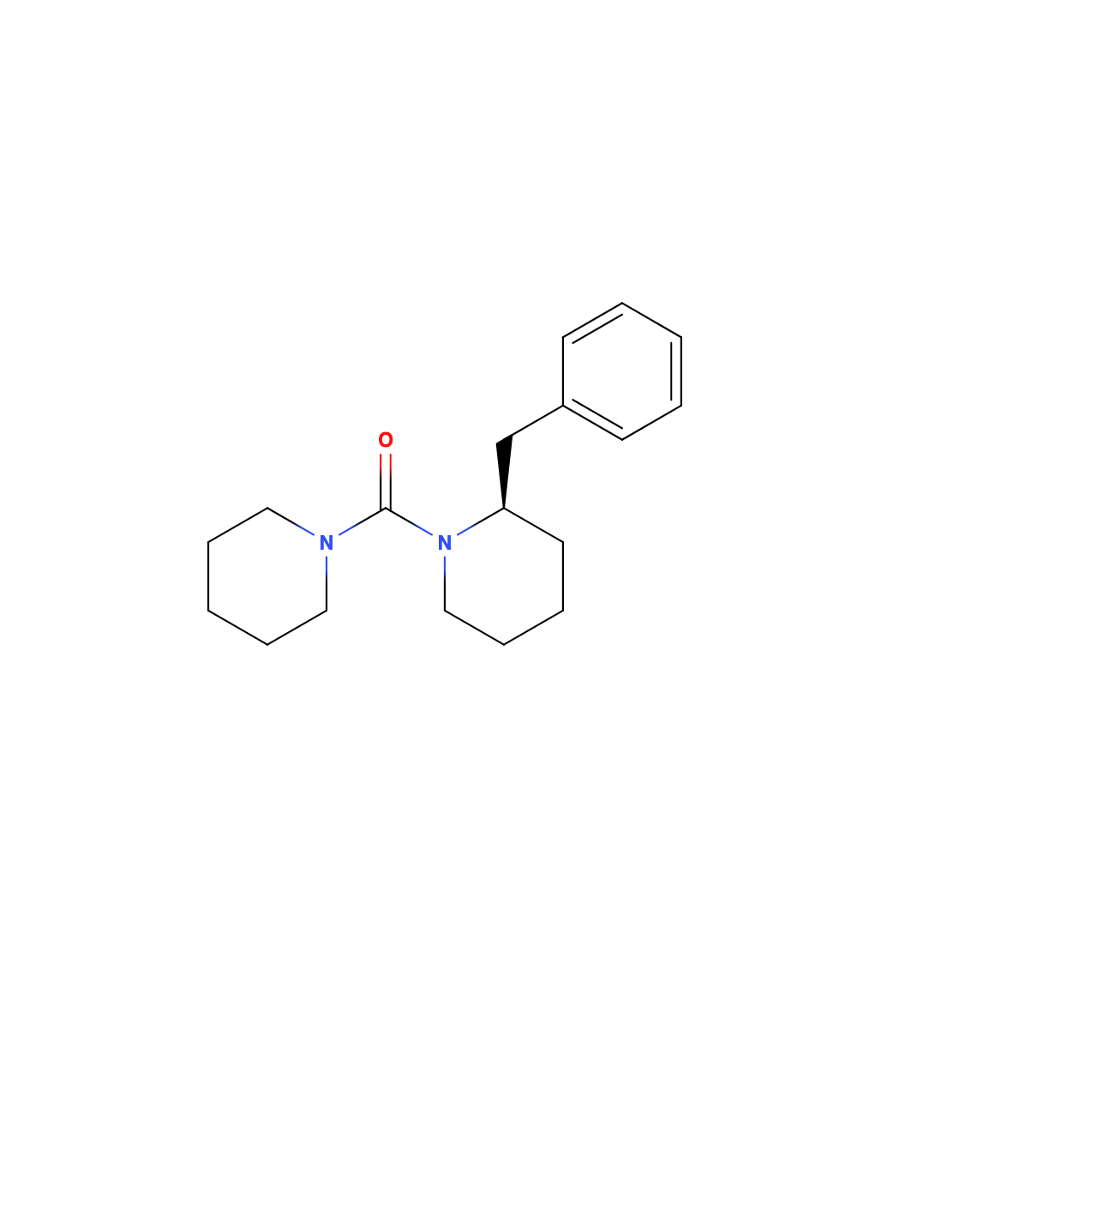
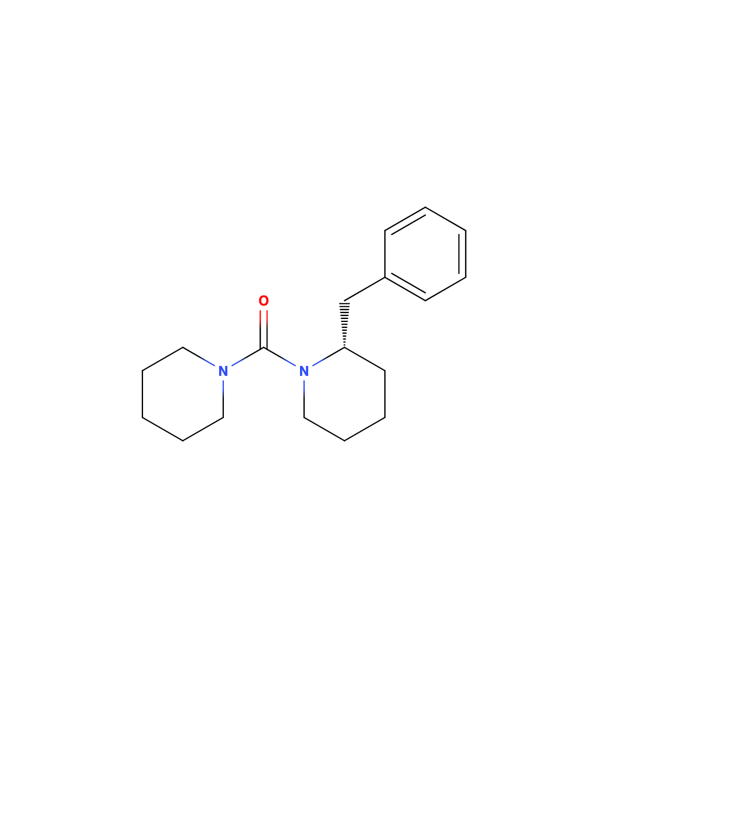
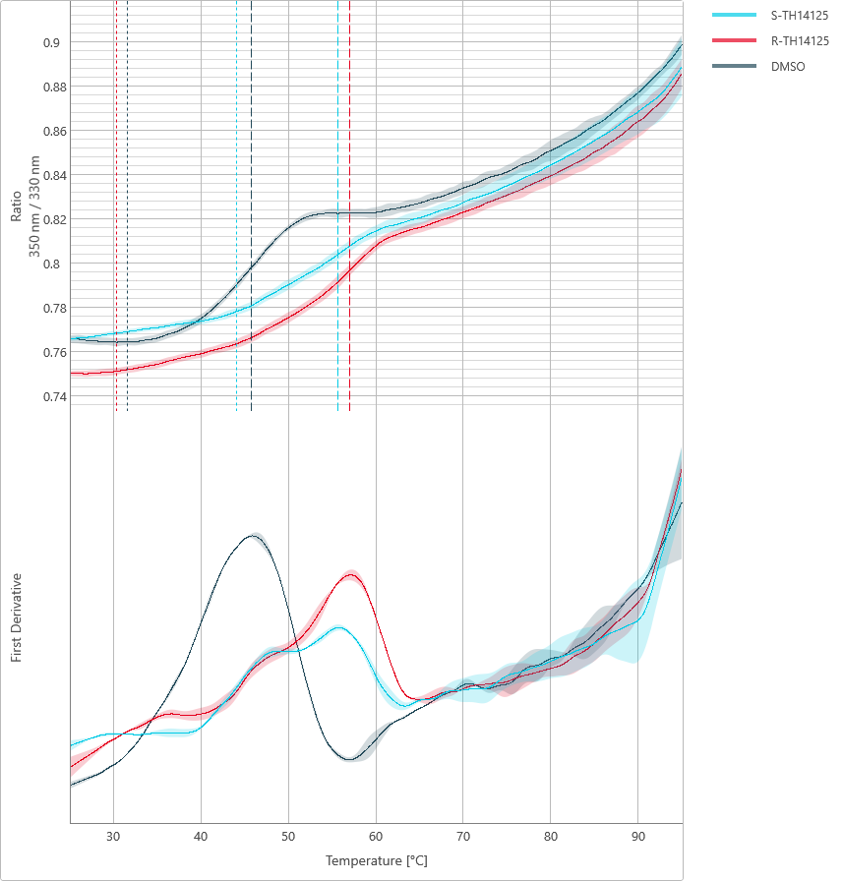
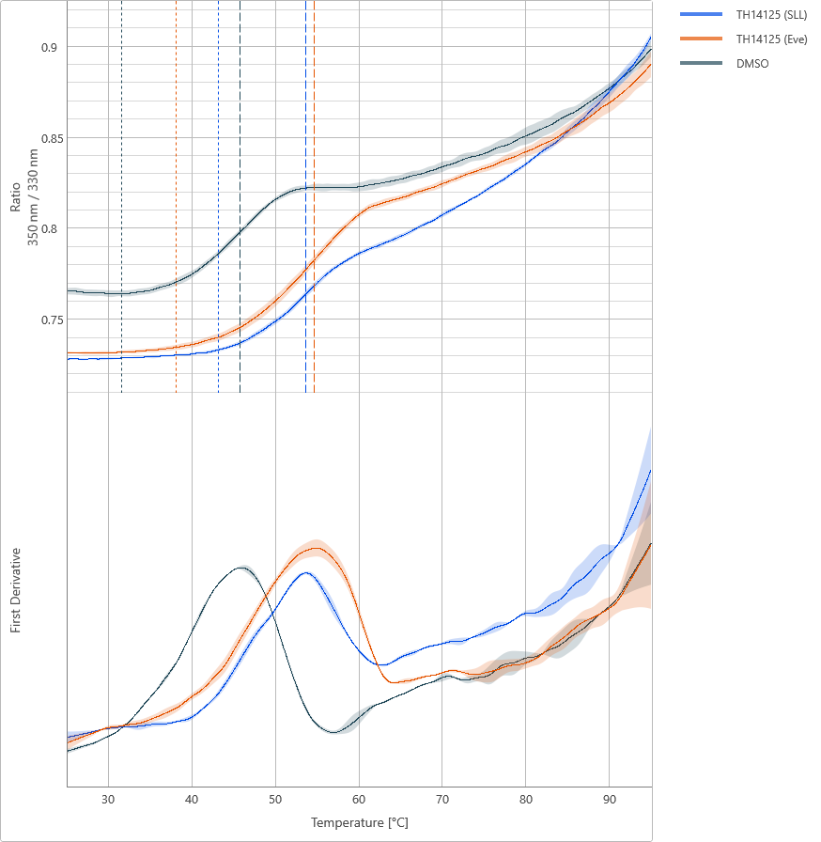
ABHD2 – nanoDSF – TH14125 enantiomeres
*
TH14125 – ABHD2i
Baggelaar et al., ACS, 2019
synthesized
by Eve Carter
4 µM ABHD2 + 40 µM compound
R-TH14125
S-TH14125
R-/S-enantiomers
Racemic mixtures
Tm (DMSO) = 45.8 °C
Tm (S-TH14125) = 55.7 °C
=(𝝙Tm=9.5)
Tm (R-TH14125) = 57.0 °C
= (𝝙Tm=12.2)
Tm (DMSO) = 45.8 °C
Tm (TH14125 SLL) = 53.7 °C
= (𝝙Tm=7.9)
Tm (TH14125 UCL) = 54.70 °C
= (𝝙Tm=8.9)
Racemates synthesized at
SciLifeLab (Stockholm)
UCL

Slide 4
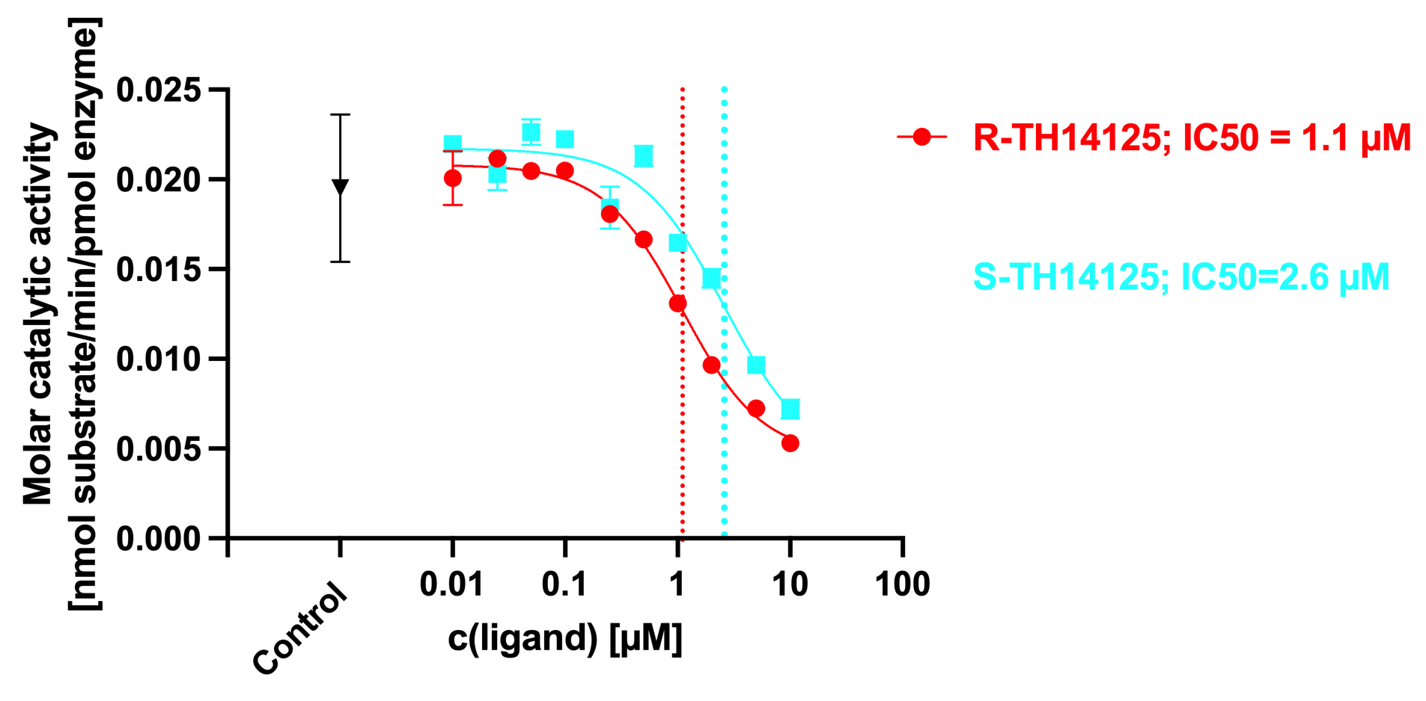
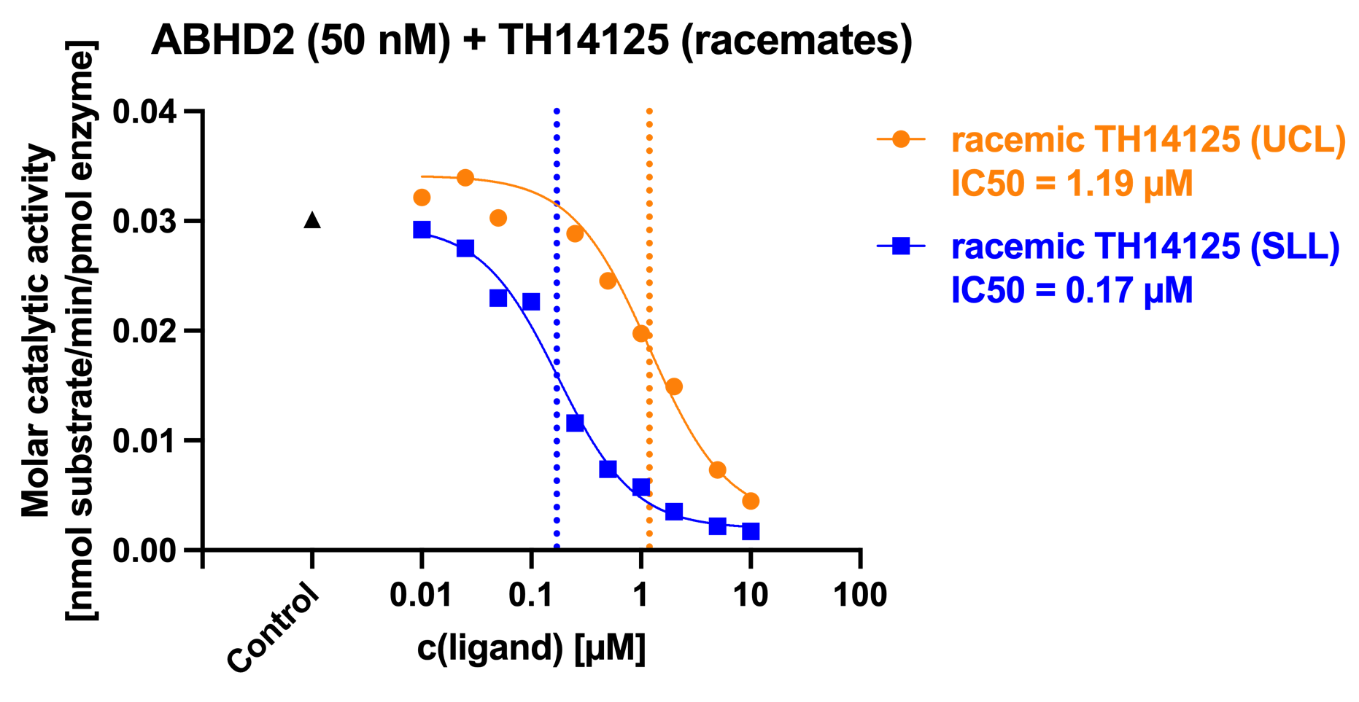
ABHD2 – Enzymatic assay – TH14125 enantiomeres
*
TH14125 – ABHD2i
Baggelaar et al., ACS, 2019
50 nM ABHD2 + compound
R-TH14125
S-TH14125
synthesized by Eve Carter
ABHD2 (50 nM) + R-/S-TH14125
➔ No considerable difference between R- and S- enantiomer or the racemate
➔ Eve’s compound seems to have a less inhibitory than the one synthesized at SciLifeLab (SLL)

Slide 5
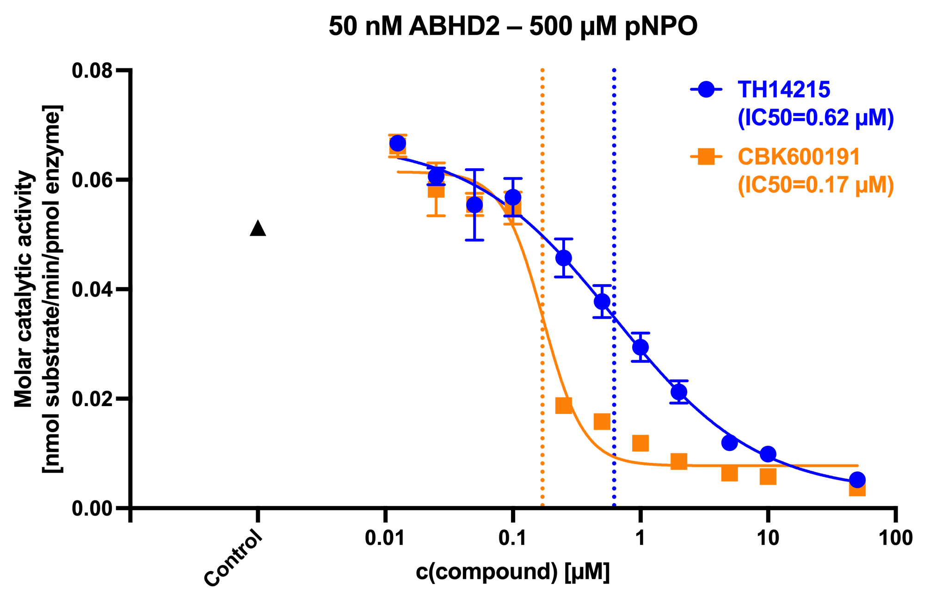
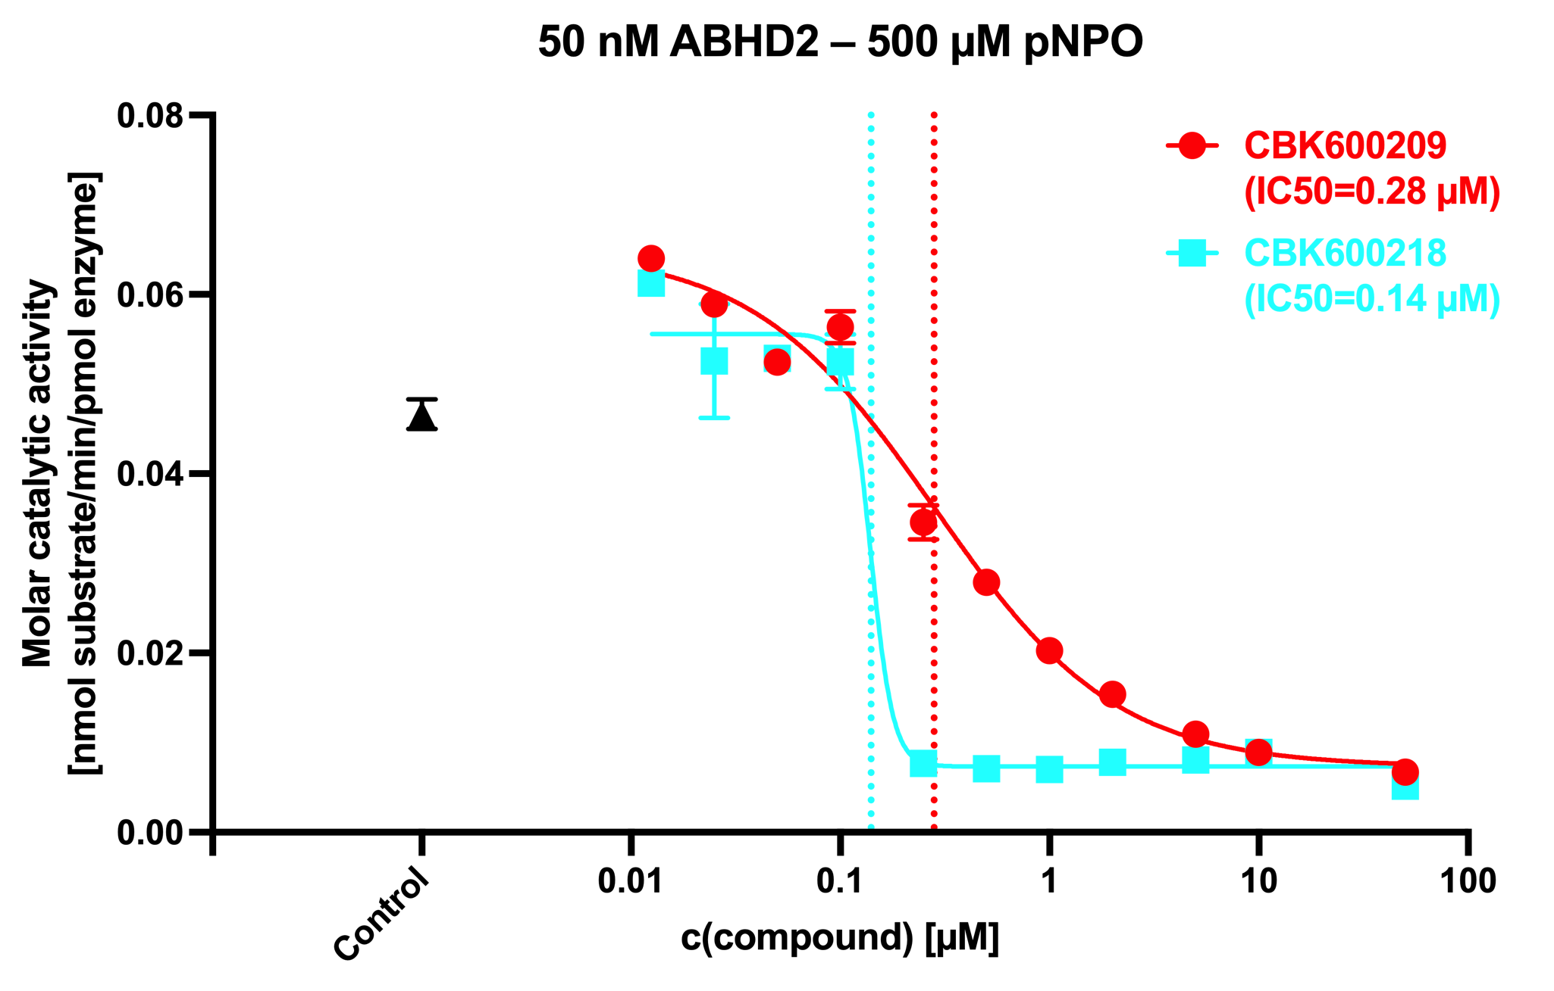
Compound | IC50(old) [µM] | IC50(new) [µM]
TH14125 (CBK600192) | 2.2 | 0.62
CBK600191 | 0.33 | 0.17
CBK600209 | 0.49 | 0.28
CBK600218 | 0.026 | 0.14

